Slide 1
Human resources slide 1
PEOPLE ANALYTICS
GROUP 1
Presented By,
Akshaya Srinivasan
Sonal Sharma
Manisha Paliwal
Praphul Kenkere Omkarmurthy

Slide 2
Human resources slide 2
INTRODUCTION
What?
The modern generation of IT mandates a fresh perspective on work and culture, transforming HR beyond basic routine duties, to strategic business advisors
How?
The business decision-making problems that HRs encounter can be addressed effectively using Data Analytics and Business Intelligence
Why?
HR professionals may achieve a better degree of data engagement and influence difficult-to-attain company goals using the insights from visualizations
Goal
Understand the data, identify hidden patterns, and build visuals to effectively communicate them, creating a pathway to data-driven decision making

Slide 3
Human resources slide 2
RELATED WORK
Previous research concentrates on the challenges and opportunities faced by business firms in implementing HR analytics as a tool in organizations.(Tomar & Gaur, 2020)
Another group of study discusses human resource analytics and illustrates how it has been successfully implemented by google to enable better decision-making. (Shrivastava et al., 2018)
The other group of study focuses on the practices of people analytics to identify the gaps, priorities, and recommendations for ethical practice.(Tursunbayeva et al.)
Few studies also focuses on the technique of using industry data to let HR tackle employee retention and dissatisfaction

Slide 4



Human resources slide 2
PROBLEM STATEMENT
HR Overview
How to get a high-level overview of each department's employee strength, Attrition trends, No. of employees in respective job titles, locations , and diversity?
Attrition trends in the company
Who leaves the company and when? How can the company retain their best and loyal employees?
Diversity in the company
Does the company promote diversity and inclusion?
Are all employees treated fairly?
Complete Employee Profile
How to recognize loyal employees in sought after positions while onboarding a new project ?
HUMAN RESOURCES

Slide 5




Human resources slide 2
METHODOLOGY
DATA COLLECTION
DATA CLEANING
DATA
PRE-PROCESSING
DATA VISUALIZATION
Real World Fake Data is a community project initiative by Mark Bradbourne
HR data is sourced in .csv format
Handling missing/NULL values
Removing outliers, if any
Reformatting the data
Transforming data into required format
Creating derived attributes
Bundling data into groups, bins and sets
Overview
Termination Analysis
Diversity Analysis
Employee Info

Slide 6
Human resources slide 2
DATA COLLECTION
DATA SOURCE
Real World Fake Data (RWDF) is a community project initiative by Mark Bradbourne
RWDF is typically used to create reusable corporate level business dashboards using tableau
The data is openly available and can be downloaded in .csv format
QUICK STATS
22,438 Employee records with 13 attributes
Includes Name, D.O.B, Gender, Department, Job Title, Location, Race, Hire Date and Termination Date
RWFD includes 13 Departments with 185 distinct job positions

Slide 7
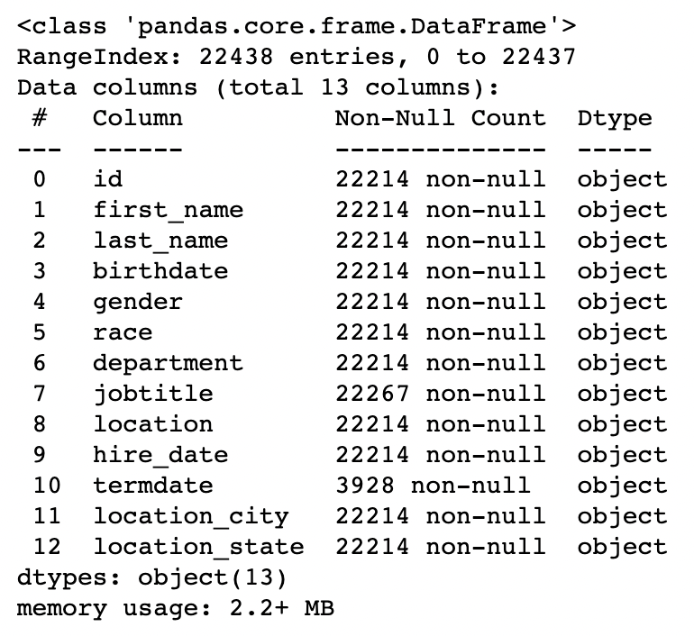
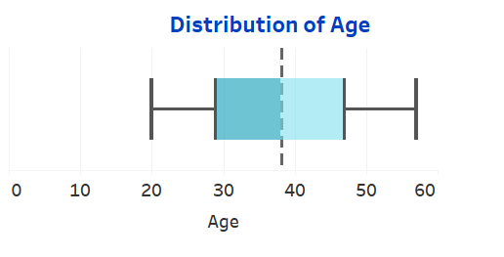
Human resources slide 2
DATA CLEANING
The data had 224 NULL valued records, which were removed
There were few Employees with a future termination date (could be contract workers or data anomalies). Since the reason behind this was unknown, those termination dates weren’t considered for analysis
Outlier analysis was performed on all attributes, from which we found no significant outliers to be present
For instance, the distribution of age groups in the company ranges from 20 to 60 years, with no outliers

Slide 8
Human resources slide 2
DATA PRE-PROCESSING
Derived Attributes
Age
Tenure
Gender Diversity %
Age of the Employee, calculated from Birthdate
Years associated with the company, calculated from Hire and Termination date
Percentage of Females in the company
Age at Exit
Employee Status
Race Diversity %
Age of the Employee as on Termination date for exited employees
Active Employees still work for the company, Inactive ones have exited
Percentage of People of Color in the company

Slide 9
Human resources slide 2
DATA PRE-PROCESSING
Groups
Age Bins
Gender Group
Employees aged 20-30, 30-40, 40-50 and >50 are bundled together
Females and Non-confirming Employees are grouped as Females
Race Group
Alaska Natives, Asians, African Americans, Hispanic or Latinos, Native Hawaiian or Other Pacific Islander and employees with Two or more races are grouped together as People Of Color

Slide 10
Human resources slide 2
DATA VISUALIZATION
People Analytics Dashboard

Slide 11
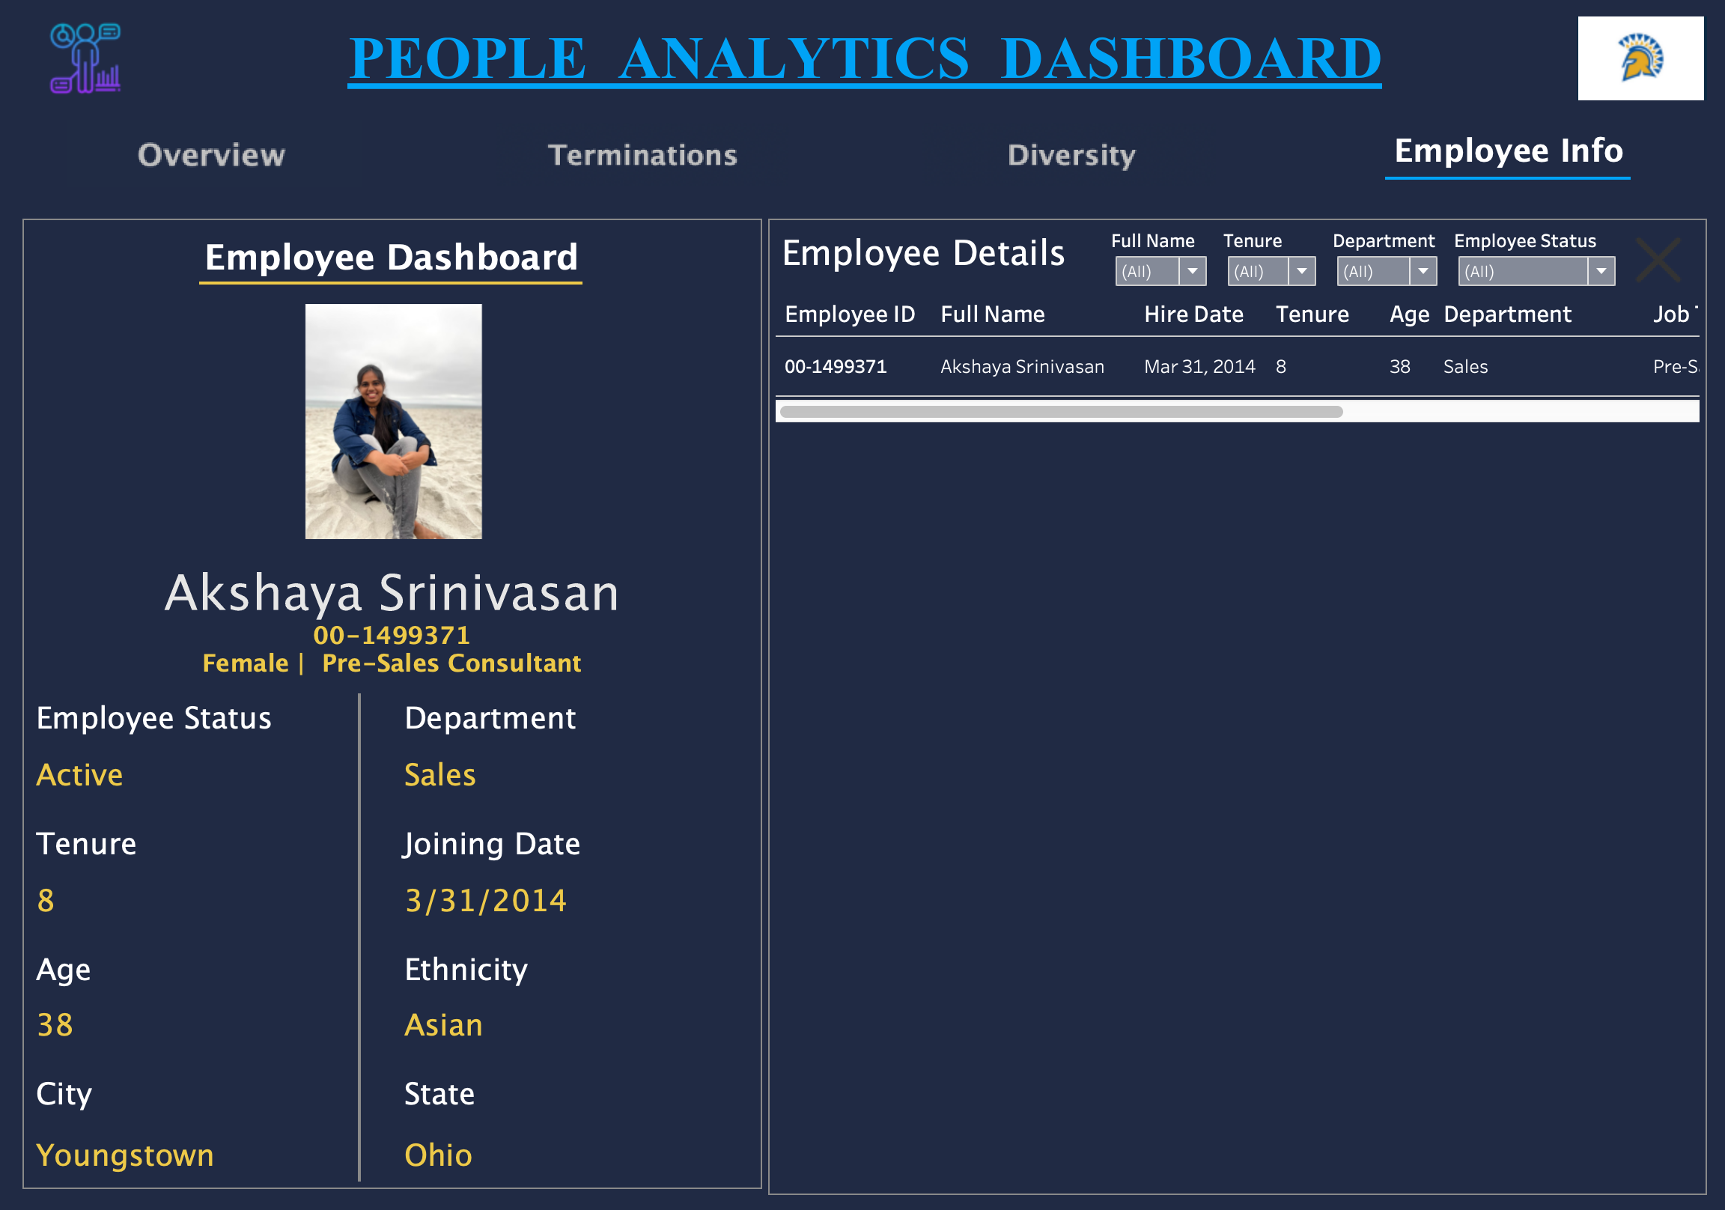
Human resources slide 2
Employee Info with Row Level Security
Employees can access only relevant information that they have been given access to!
The same feature can be scaled to restrict/provide access to selected columns and hash the remaining information

Slide 12
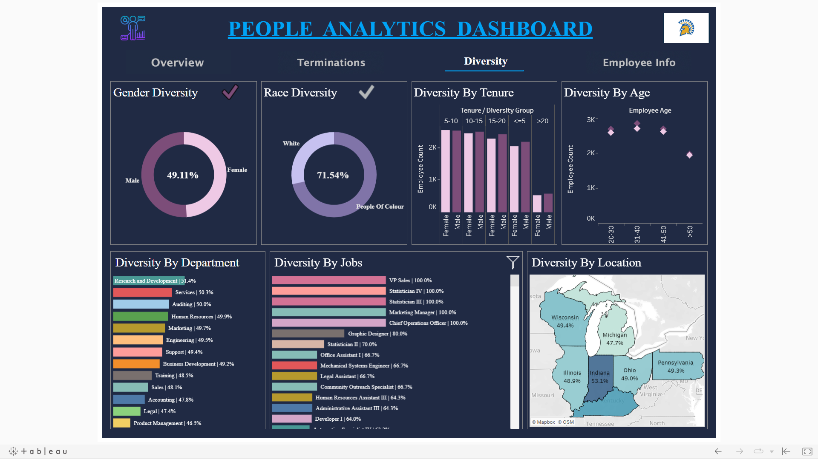

Human resources slide 2
DASHBOARD NAVIGATION GUIDE
Click on the People Analytics icon to redirect to the webpage of data source
Click on the SJSU icon to navigate to the University’s webpage
Click on the Gender or Race Diversity tick to view corresponding diversity dashboard
Click on the Tabs to navigate to the corresponding dashboard
Click on the Filter icon to Show/Hide filters

Slide 13
Human resources slide 2
FINDINGS AND INSIGHTS
Findings | Insights
While the overall race diversity of the company is good, there few roles such as VP of Sales, Assistant Manager, Attorney, etc., in which People of Color come out as minority groups | With 22% being USA's average race diversity percentage, RWFD's 71.54% shows a strong sign of diversity and equality in opportunities
The company's overall and department-wise Gender diversity percentage is greater than 45% | Although in general percentage of women in tech is only around 25%, RFWD's consistent 45% or higher gender diversity in all job roles is a great sign of equality
In 2021, the number of terminations reached a new peak, with even well experienced employees leaving the company | The attrition peak in 2021 , which is also the great resignation year of USA, could primarily be due to Low pay, lack of respect in workplace, issues with childcare and excessive workload
Employees aged 24-26 are most prone to exiting within 4 years of joining the company | Less experienced employees switch jobs as they tend to take high risks, lookout for better pay and alignment between personal values and organizational priorities

Slide 14




Human resources slide 2
RECOMMENDATIONS
As RWFD employees come from a diverse group, by focusing on minority recruitment and branding themselves as an organization that values people from all walks of life, they can continue maintaining their diverse workforce
RWFD could continue recruiting more women while ensuring that they get paid equally as their male counterparts
RWFD could boost their employment retention strategy by giving employees creative freedom and an environment where they can prioritize their professional growth while maintaining a great work life balance​
RWFD can revise their competitive compensation and benefits and foster a pleasant work environment to talented professionals​

Slide 15



Human resources slide 2
FUTURE WORK
Unbiased hiring process – a challenge for every organization which happens often unconsciously. This can be solved by implementing AI and data solutions to eliminate the bias​
Personalized work- Employees’ personal life and work are not mutually exclusive. Intersection and overlap exist which can impact either way. Targeted skills development, creating unique experience for the employees will lead to retention​
Skill gaps- Organizations that can identify the specific skills they need—not just the requisitions required to fill will have a leg up in the war for talent​
Notes:
https://www.visier.com/blog/trends/3-ways-people-analytics-future/ https://pattyrn.com/blog/3-ways-the-future-of-people-analytics-is-changing

Slide 16
Human resources slide 2
REFERENCES
Data Source
Employee Information Image
Diversity Image
Attrition Rate Image

Slide 17

Human resources slide 2
THANK YOU

